Slide 1
Resolvr Case Study 2020
Airplane Consumer Satisfaction Optimization using Machine Learning Applications
Team Members -
Anuraag
Deepak Kumar
Pranav Dev
Dushyant Singh Udawat

Slide 2
Table of Contents
Sr. No. | Title | Page
1 | Exploratory Data Analysis - Univariate | 3
2 | Exploratory Data Analysis - Bivariate | 4-5
3 | Data Preprocessing | 6
4 | Model Selection | 7
6 | Recommendations | 8
7 | Bibliography | 9

Slide 3
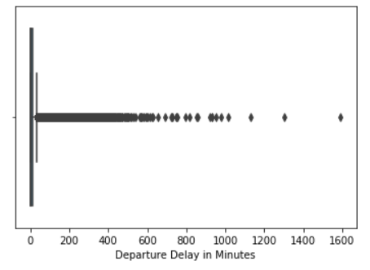
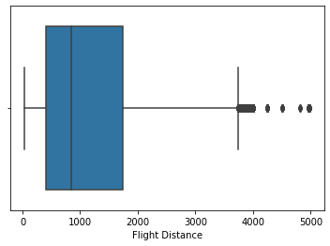
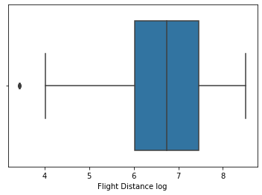
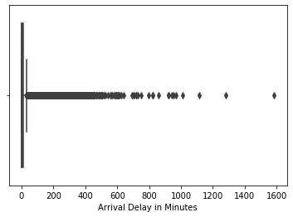
Exploratory Data Analysis-Univariate Analysis
Outliers can be observed in three of the features- “Flight Distance”, “Arrival Delay in minutes” and “Departure Delay in minutes”.
For “Flight Distance”, it can be assumed to be somewhat normally distributed (probability of very short paths similar to that of very long path) hence log transformation is suggested
For the latter ,two very high time taken should have lesser occurrences as we are talking about time delay
Hence winsorization(clipping data considered to be erroneous) is not suggested. Scaling should be preferred instead.

Slide 4
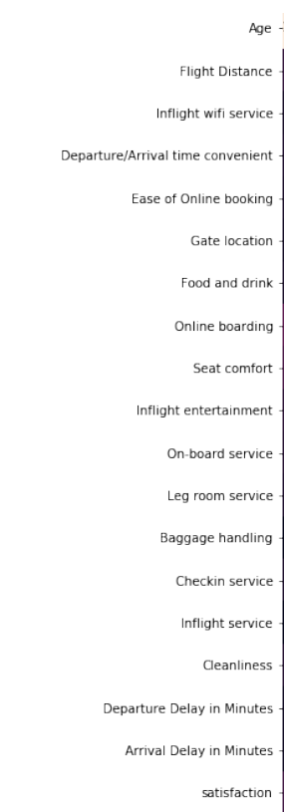
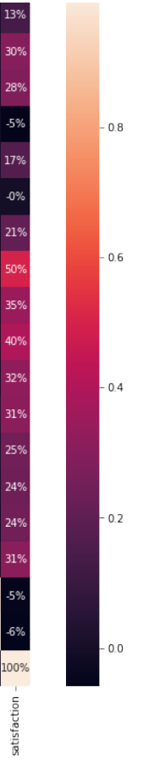
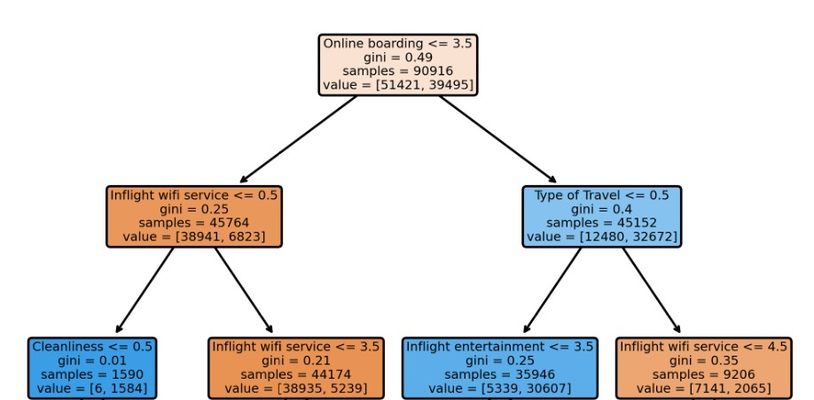
Non useful parameters
Most useful parameters
Exploratory Data Analysis- Bivariate Analysis
Correlation with satisfaction based feature selection
Gate Location- 0%
Departure Delay in minutes- -5%
Arrival delay in Minutes- -6%
Departure/Arrival Time convenient- -5%
Decision tree presenting the increasingly significant Decisions (Bottom to Up)
Online Boarding- 50%
Inflight Entertainment- 40%
Seat Comfort- 35%
On Board Service- 32%
Leg Room Service- 31%
Cleanliness- 31%
Flight Distance- 30%
Correlation Table

Slide 5
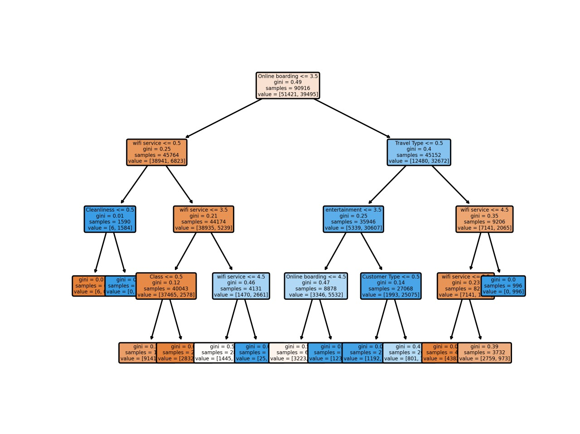
Complete Decision Tree

Slide 6
Data Pre-Processing
Outlier treatment
Missing Value Treatment
Log transformation was applied on “Flight Distance” to normalize the values and reduce right-skewness
Scaling was employed on “Arrival Delay in Minutes” and “Departure delay in Minutes”
Keeping outliers in mind median was imputed for numerical features and mode for categorical features.
“Arrival Delay in Minutes” had the highest number of missing values-363 (although its correlation with “satisfaction” is 4%)

Slide 7
Comparison of Various Models
The dataset was tested under different models to achieve best possible prediction accuracy. Stratified k-fold cross validation was employed to reject any chances of overfitting and justify the accuracy. Confusion matrix model was used to get the cross validation accuracy.
*Stacking XGBoost and CatBoost to Logistic regression Accuracy->96.45% (with threat of overfitting!)
Insights:
Performance of XGBoost and Random Forest turning out to be similar implies that the dataset is noisy (variance is significant).
CatBoost emerging as the best model is justified as most number of features of the dataset are ordinal/categorical with binary class prediction, and CatBoost is designed to handle it.
Underperformance of logistic regression can be understood from the fact that number of features are less (24, it works better for >30 features) that too with few numerical features.
Model | Accuracy% | Tuning Requirement | Computation Speed
Random Forest | 96.35 | Yes | High
XGBoost | 96.38 | Yes | High
Logistic Regression | 86.37 | No | Low
Multilayer Perceptron(MLP) | 95.5 | Yes | Very High
Catboost | 96.51 | No | Moderate

Slide 8
Recommendations for Improvements -
Most Correlated variables are - Online Boarding, Inflight Entertainment, Seat Comfort, On Board Service, Leg Room Service, Cleanliness, Flight Distance. Hence these features require more analysis to gather more informative insights.
Less correlated features like Gate Location, Departure Delay in minutes, etc. with “satisfaction” can either imply that the overall population is somewhat unaffected by that facility or it has reached saturation for Blue Delta Airways and does not require much improvement.
Inflight Wi-Fi has great impact on Satisfaction based on the SHAP model. One can infer that most of the times when a customer sits in the plane he/she is dependant on Wi-Fi for work and entertainment. The Inflight Entertainment not being a more decisive part of the satisfaction can be supplanted by Wi-Fi in Airplanes to provide customers with higher levels of satisfaction. Also, further investigation into trends of Wi-fi services should be investigated.Also, the trend of Inflight Wifi is non-linear, it requires further attention.
Although correlation of Inflight Entertainment is significant with satisfaction, it is also correlated to several other features which subdue its relative importance.
As explained by the explainability models, Online Boarding System has a systematic inefficiency, which needs to be identified on the field, and analysis needs to be performed to check the opportunity offered for improvement.
Loyal Customers being more satisfied should be taken in inverse sense that customers can be converted to Loyal Customers if satisfaction is generally improved.
Also online survey forms can be distributed among passengers while connecting to the wifi in order to extract useful qualitative information.

Slide 9
Bibliography
Explaining Black Box Models: Ensemble and Deep Learning Using LIME and SHAP
CatBoostClassifier
sklearn.neural_network.MLPClassifier — scikit-learn 0.23.2 documentation
Welcome to the SHAP Documentation — SHAP latest documentation
https://towardsdatascience.com/6-different-ways-to-compensate-for-missing-values-data-imputation-with-examples-6022d9ca0779

